Slide 1
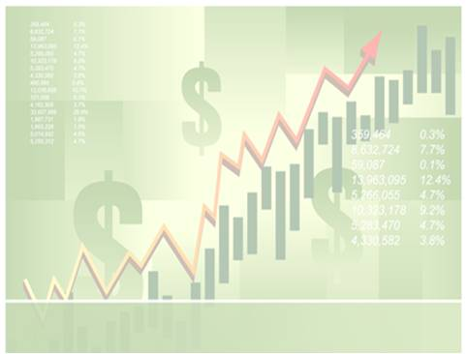
BU 8201 Tutorial 6:
Stock and Their Valuation
Group 7: Stamford Seah, Wee Chee How, Carolina Tan, Kimberly Koh Don Sin

Slide 2
Stocks
2 types of stocks: Preferred stock and Common stock
Preferred Stock | Common Stock
No voting rights | Voting rights
Dividend will be paid first | Dividend paid after Preferred stock
During liquidation, preferred stock holders get paid first | During liquidation, common stock holders get paid later
Notes:
The 2 difference types of stocks available are preferred stock and common stock
Table are the differences

Slide 3

Intrinsic value , stock price and how to estimate intrinsic value of common stock
What is intrinsic value?
Stock price in equilibrium
Below intrinsic value -> undervalued -> buy
Above intrinsic value -> Overvalued -> Sell
3 Method: Discounted Dividend Model (DDM), Corporate Valuation Model and Firm Multiples Method (e.g P/E ratio)
Notes:
What is intrinsic value?
3 method to calculate stock value

Slide 4
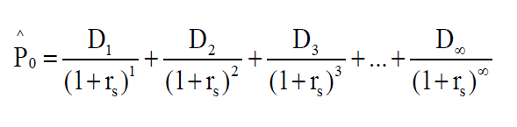
Discounted Dividend Model (DDM)
Constant Growth in Dividends or Non-Constant Growth in Dividends
Value of a stock is the present value of the future dividends expected to be generated by the stock.
rs : required rate of return on stock
Notes:
2 scenarios of DDM
Similar to CF analysis

Slide 5
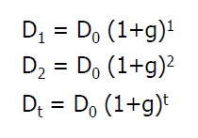
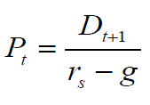
Discounted Dividend Model (DDM) - Constant Growth Stock
Stock’s dividends are expected to grow forever at a constant rate, g.
In general, (Gordon Model)
In order for Gordon model to be valid, r_{s} > g and g is expected to be constant forever

Slide 6
(DDM) - Steps to calculating the intinsic value of a stock with constant growth
Calculate the required rate of return (r_{s}) using SML
r_{s} = r_{RF} + (r_{M} – r_{RF})b
2. Find the expected dividend stream and their PVs
3. Using Gordon Model to calculate Intrinsic value
Notes:
-

Slide 7


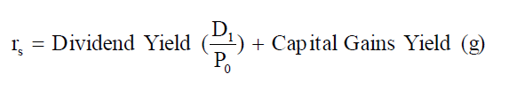

(DDM) - Constant Growth Model: How will stock price grow?
Capital Gains Yield, = g
Dividend Yield,
Total returns,
So, how do you estimate growth?

Slide 8
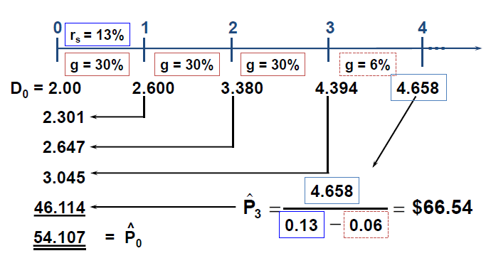
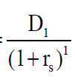
(DDM) – Valuing Non-Constant Growth Stock
Growth is not constant at first, but will eventually become constant
Notes:
Using formula
For period 2, power of 2

Slide 9
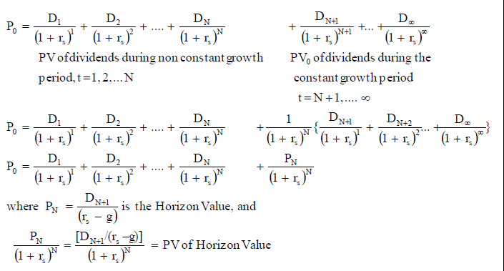
Deriving the formula

Slide 10
(DDM) – Find expected dividend and capital gains yields of Non-Constant Growth Stock
For non-constant part
Capital Gains Yield,
Dividend Yield,
For Constant part
Just use Gordon Model
-

Slide 11
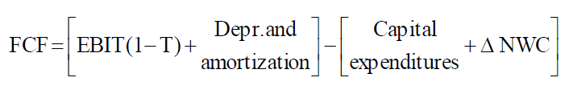
Corporate valuation model
Also the Free Cash Flow method (FCF). Entire value of firm equals the present value of the firm’s free cash flows

Slide 12
Applying the Corporate valuation model
Find the market value (MV) of the firm
MV of firm = PV of the firm’s future FCFs.
Find MV of common stock
MV of common stock = MV of firm - MV of firm’s debt and preferred stock
Find intrinsic stock price (value)
P₀ = MV of common stock / Number of shares outstanding

Slide 13
Issues regarding Corporate valuation model
Because not all companies pay dividends. Often preferred to the discounted dividend model
Similar to discounted dividend model, assumes at some point free cash flow will grow at a constant rate.
Terminal value (TVN) represents value of firm at the point that growth becomes constant

Slide 14
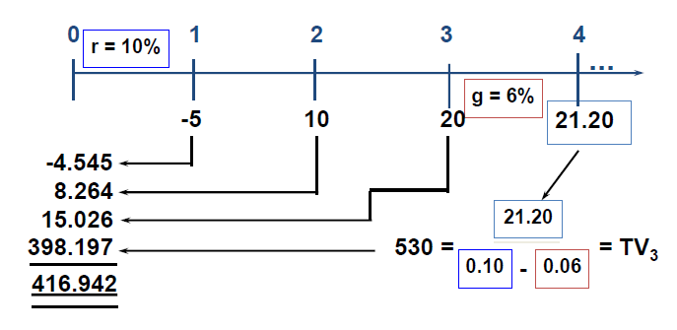
Some examples of applying Corporate valuation model
g_{FCF} = 6%, Weighted Average Cost of Capital (WACC) = 10%
SIMILARITY

Slide 15
Some examples of applying Corporate valuation model
Firm has $40m in debt and 10m shares of stock, what is the firm’s intrinsic value per share
MV of equity = MV of firm – MV of debt
= $416.94 - $40
= $376.94 million
Value per share = MV of equity / # of shares
= $376.94 / 10
= $37.69

Slide 16
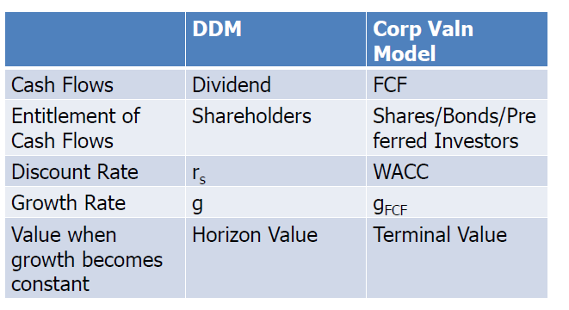
DDM vs Corporate Valuation Model

Slide 17
Using the multiples of comparable firms
P/E
P/CF
P/Sales

Slide 18

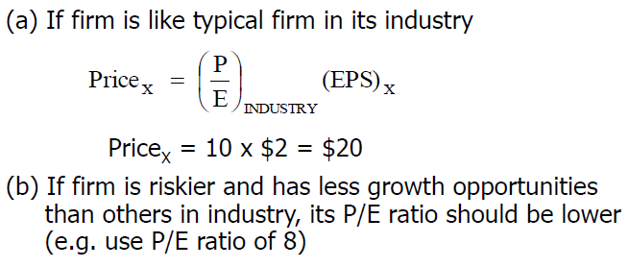

P/E

Slide 19
P/E
P/E ratio shows how much investors are willing to pay for each dollar of reported earnings.
Riskier stocks should have lower P/E.
Firms with higher growth opportunities should have higher P/E ratios.
If a stock’s P/E is above its industry average and if its growth potential and risk are similar to other firms in the industry, this may indicate its stock’s price is too high (overvalued).
Drawback of P/E approach: depends on reported accounting earnings (Net Income). Use P/CF and P/Sales as alternative measures

Slide 20
What is market equilibrium?
In equlibrium, two conditions must be fulfilled:
Current market stock price equals its intrinsic value (P₀ = )
Expected return,
must equal Required Return, r_{s} = r_{RF} + (r_{M} – r_{RF})b

Slide 21
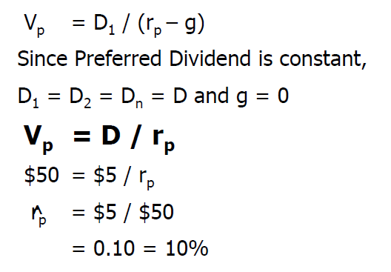
Preferred stocks
Receive fixed dividend that must be paid before common stockholders
Like bonds, but dividends not compulsory

Slide 22
TUTORIAL ANSWERS

Slide 23
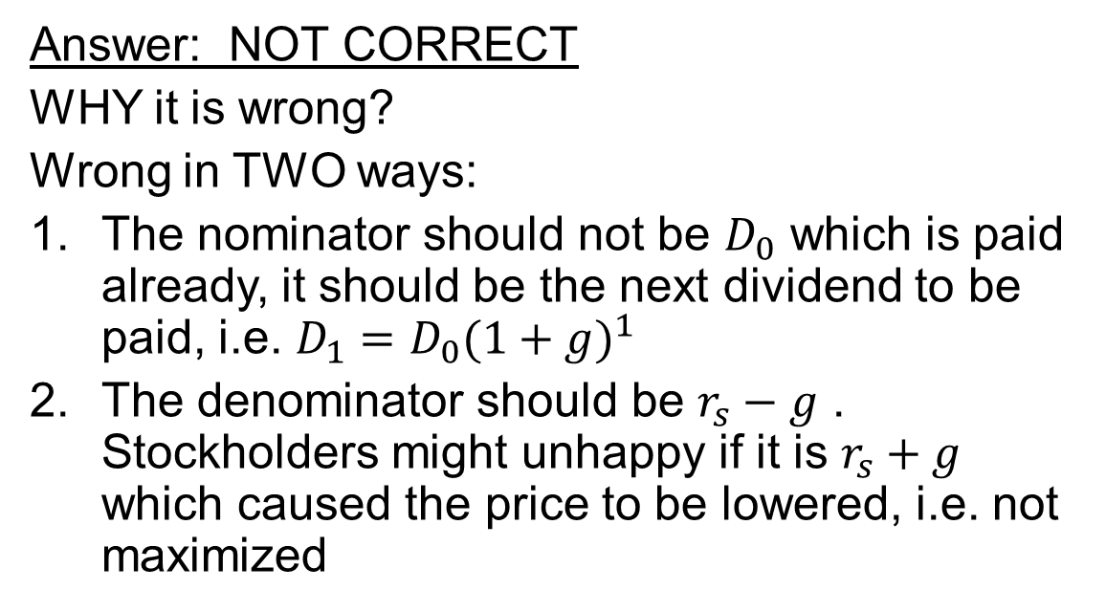
Q10-2 Is the following the correct equation for finding the value of a constant growth stock? Explain.
Answer: NOT CORRECT
WHY it is wrong?
Wrong in TWO ways:
The nominator should not be $D_{0}$ which is paid already, it should be the next dividend to be paid, i.e. $D_{1}=D_{0}(1+g)^{1}$
The denominator should be $r_{s}−g$ . Stockholders might unhappy if it is $r_{s}+g$ which caused the price to be lowered, i.e. not maximized

Slide 24
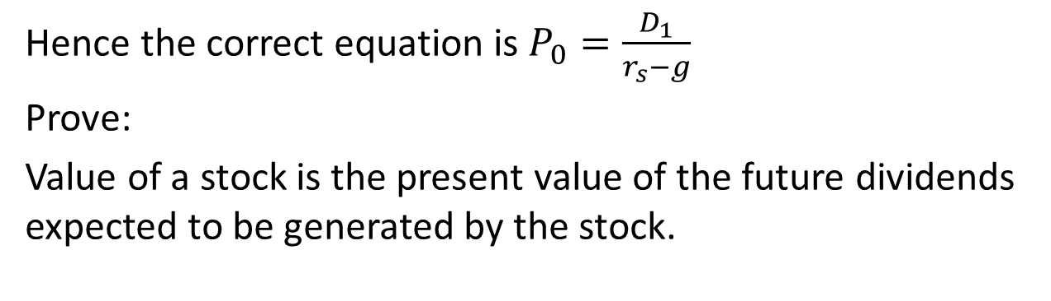


Hence the correct equation is $P_{0}=\frac{D_{1}}{r_{s}−g}$
Prove:
Value of a stock is the present value of the future dividends expected to be generated by the stock.
$$D_{1}$$
$P_{0}$ is a sum of Geometric Progression, GP.
(ref: Slide 9 of lecture notes)
First term, $a=\frac{D_{1}}{1+r}=\frac{D_{0}(1+g)}{1+r}$
Common ratio, $k=\frac{2nd term}{1st term}=\frac{\frac{D_{0}{(1+g)}^{2}}{{(1+r)}^{2}}}{\frac{D_{0}(1+g)}{(1+r)}}=\frac{(1+g)}{(1+r)}$

Slide 25
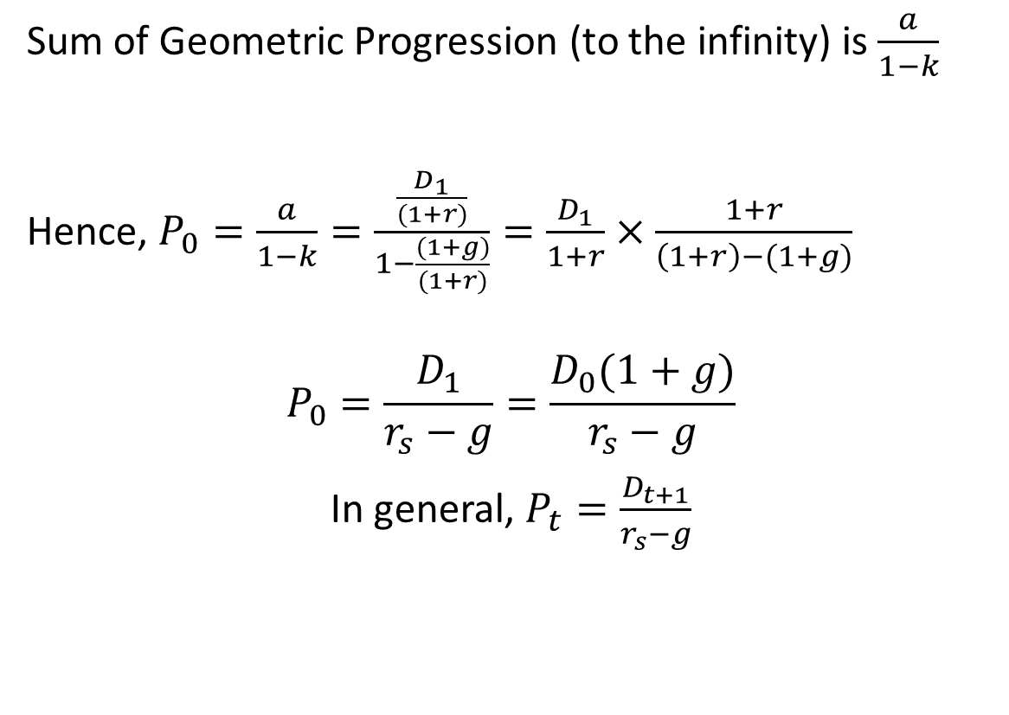
Sum of Geometric Progression (to the infinity) is $\frac{a}{1−k}$
Hence, $P_{0}=\frac{a}{1−k}=\frac{\frac{D_{1}}{(1+r)}}{1−\frac{(1+g)}{(1+r)}}=\frac{D_{1}}{1+r}×\frac{1+r}{\left(1+r\right)−(1+g)}$
$$P_{0}=\frac{D_{1}}{r_{s}−g}=\frac{D_{0}(1+g)}{r_{s}−g}$$
In general, $P_{t}=\frac{D_{t+1}}{r_{s}−g}$

Slide 26

Q10-2 Two investors agree on expected value of D1, expected future dividend growth rate and riskiness of the stock. Should both of them pay the same price where they hold the stock for 2 years and 10 years respectively?
I hold for ten years, should we pay the same price for Cheung Kong’s stock?
I hold for two years
Investor A
Investor B

Slide 27
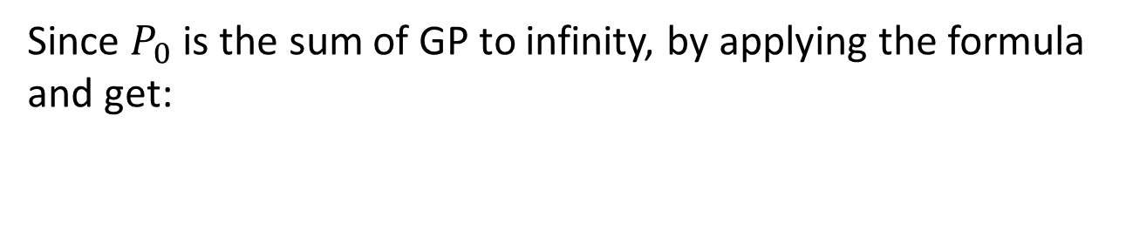
For Investor A (hold 2 years), the price he would need to pay for the stock is:
Recall that the price is sum of all future dividends
Since $P_{0}$ is the sum of GP to infinity, by applying the formula and get:

Slide 28
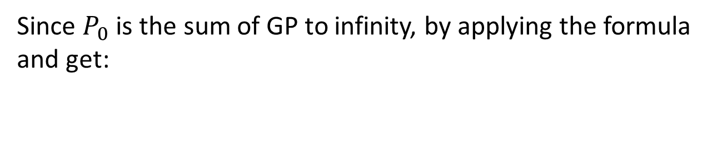
For Investor B (hold 10 years), the price he would need to pay for the stock is:
Since $P_{0}$ is the sum of GP to infinity, by applying the formula and get:

Slide 29
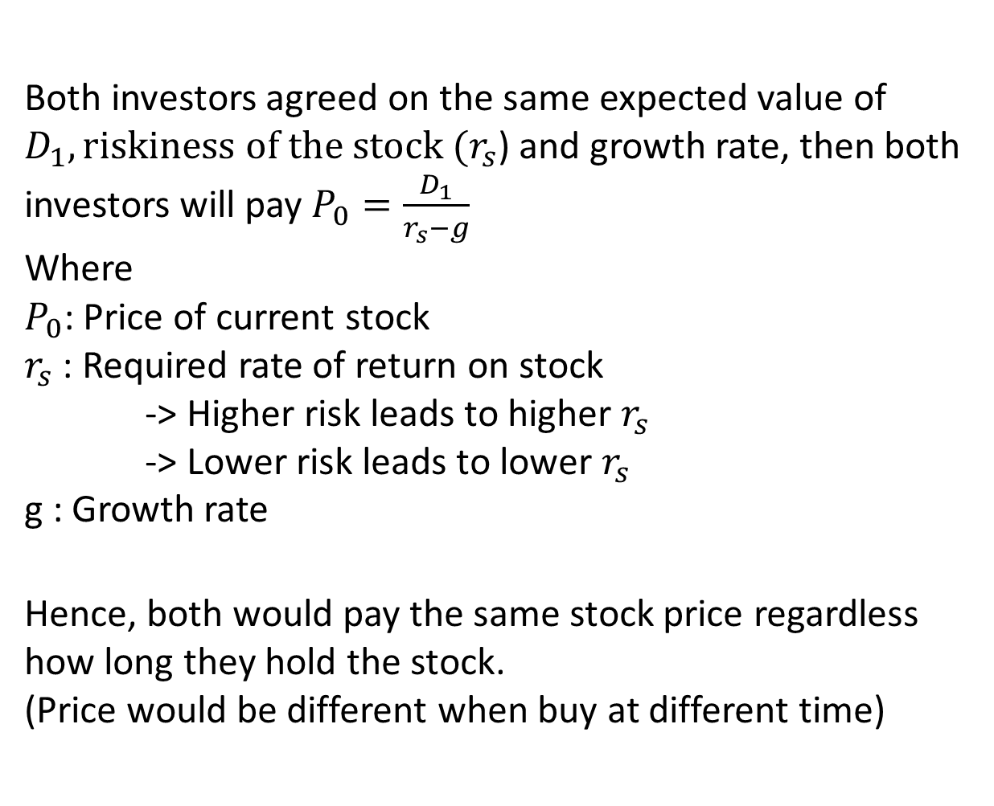
Both investors agreed on the same expected value of $D_{1}, riskiness of the stock (r_{s}$) and growth rate, then both investors will pay $P_{0}=\frac{D_{1}}{r_{s}−g}$
Where
$P_{0}$: Price of current stock
$r_{s}$ : Required rate of return on stock
-> Higher risk leads to higher $r_{s}$
-> Lower risk leads to lower $r_{s}$
g : Growth rate
Hence, both would pay the same stock price regardless how long they hold the stock.
(Price would be different when buy at different time)

Slide 30
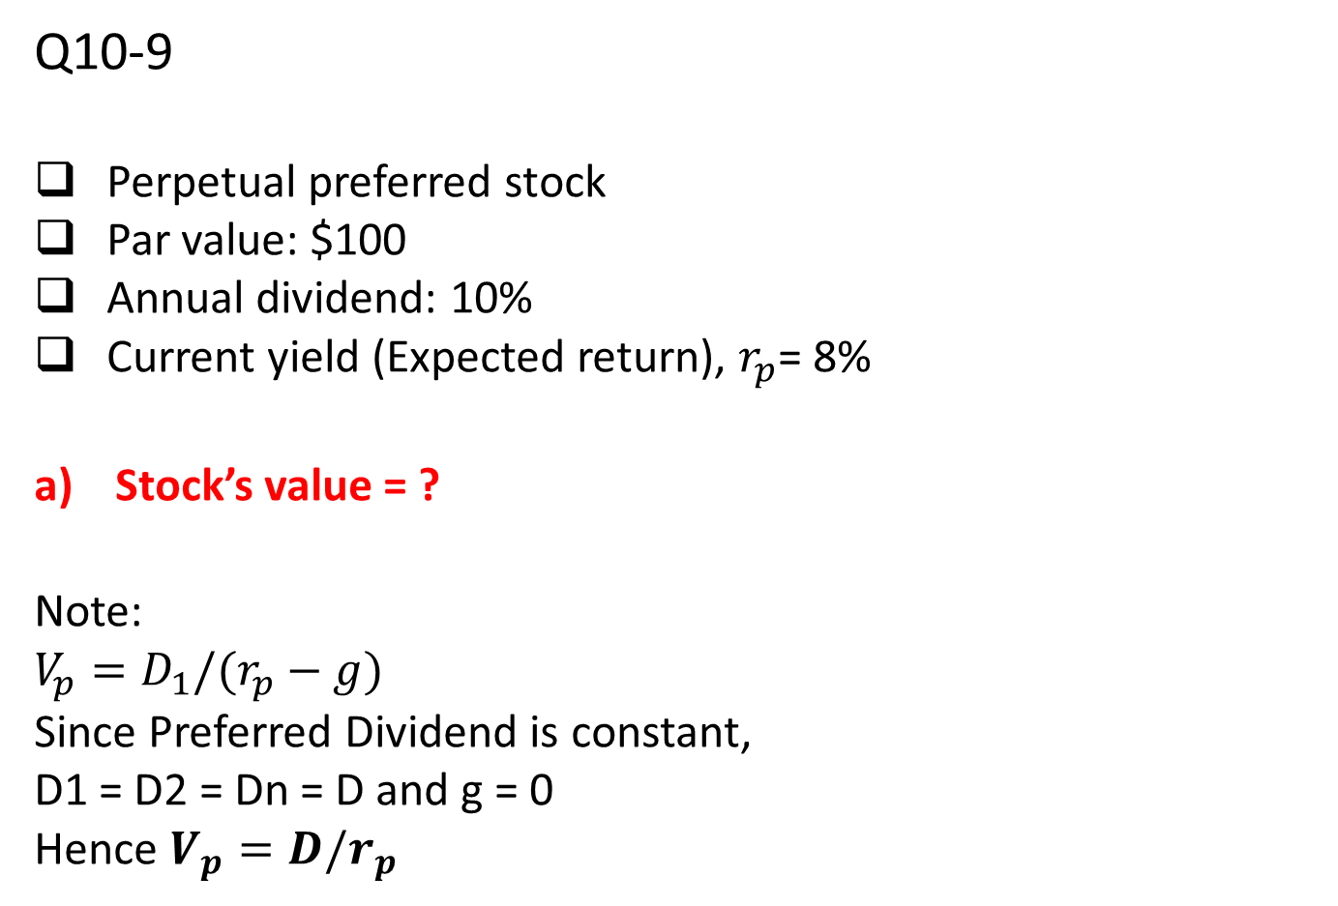
Q10-9
Perpetual preferred stock
Par value: $100
Annual dividend: 10%
Current yield (Expected return), $r_{p}$= 8%
Stock’s value = ?
Note:
$$V_{p}=D_{1}/(r_{p}−g)$$
Since Preferred Dividend is constant,
D1 = D2 = Dn = D and g = 0
Hence $V_{p}=D/r_{p}$

Slide 31
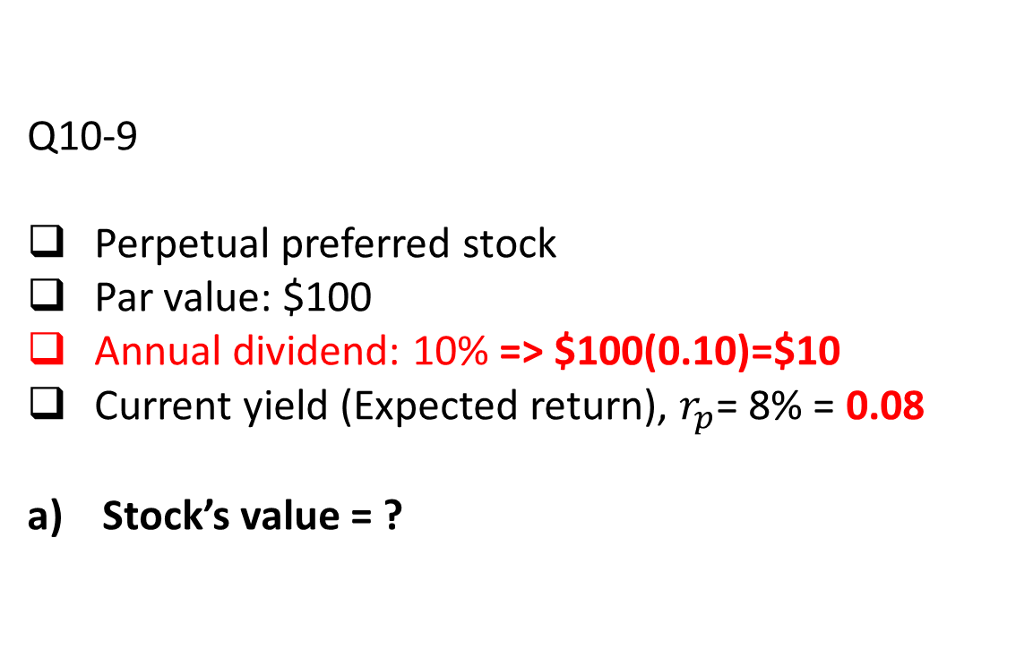
Q10-9
Perpetual preferred stock
Par value: $100
Annual dividend: 10% => $100(0.10)=$10
Current yield (Expected return), $r_{p}$= 8% = 0.08
Stock’s value = ?

Slide 32
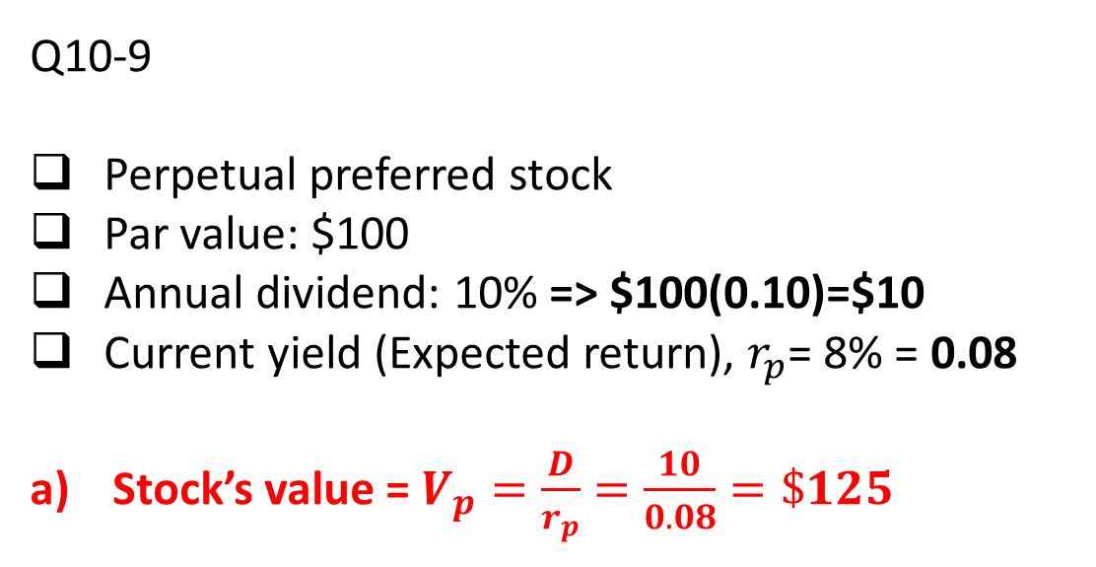
Q10-9
Perpetual preferred stock
Par value: $100
Annual dividend: 10% => $100(0.10)=$10
Current yield (Expected return), $r_{p}$= 8% = 0.08
Stock’s value = $V_{p}=\frac{D}{r_{p}}=\frac{10}{0.08}=\$125$

Slide 33
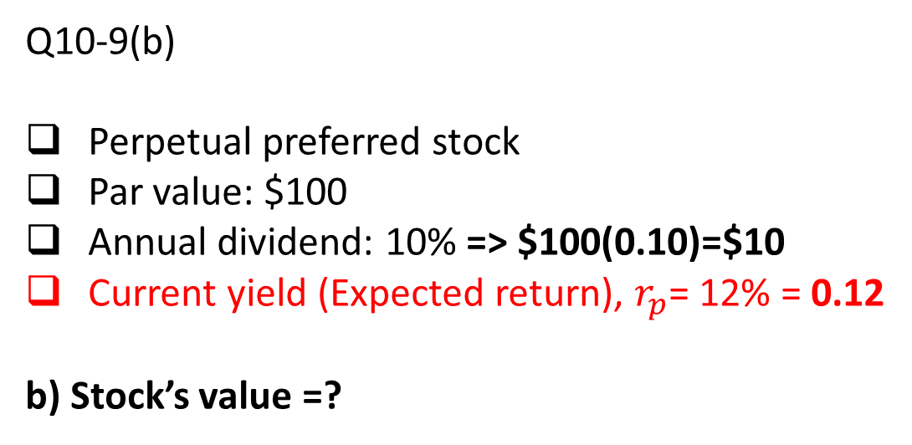
Q10-9(b)
Perpetual preferred stock
Par value: $100
Annual dividend: 10% => $100(0.10)=$10
Current yield (Expected return), $r_{p}$= 12% = 0.12
b) Stock’s value =?

Slide 34
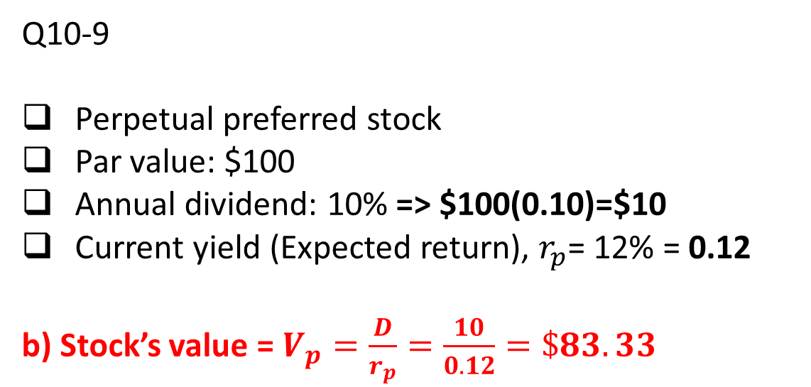
Q10-9
Perpetual preferred stock
Par value: $100
Annual dividend: 10% => $100(0.10)=$10
Current yield (Expected return), $r_{p}$= 12% = 0.12
b) Stock’s value = $V_{p}=\frac{D}{r_{p}}=\frac{10}{0.12}=\$83.33$
Some comment:
One expect the return to be higher, intuitively pay lower price to earn the appreciation from the stock price value (Capital Gain yield)

Slide 35
P 10-19 Nonconstant growth stock valuation
0
∞
1
gs = 25%
2
3
gs = 25%
gn = 5%
a)
rs = 8%
D1
D0 = 1.80
D2
D3
D₁ = D₀(1 + g_{s}) = 1.80 (1+0.25) = 2.25
D₂ = D₀(1 + g_{s})² = 1.80 (1+0.25)² = 2.8125

Slide 36
P 10-19 Nonconstant growth stock valuation
0
1
2
3
∞
rs = 8%
a)
D0 = 1.80
D1 = 2.25
D2 +
D3
PVD₁
PVD₂ +
=
=
2.25/(1.08) + [ (2.8125+98.4375)/(1.08)² ]
=
$88.89

Slide 37
P 10-19 Nonconstant growth stock valuation
Expected dividend yield = D₁/P₀
= 2.25/88.89
= 2.53 %
Capital gains yield = rs – dividend yield
= 8% - 2.53%
= 5.47%

Slide 38
P 10-19 Nonconstant growth stock valuation
Longer period of supernormal growth (5 instead of 2 years) → higher value of stock (as amount of dividends stockholders receive increases)
rs = 8% → remains unchanged; but the distribution between dividend yield and capital gains yield will differ
Dividend yield will start off lower → because DY = D1/Po; when Po increase (more dividends), DY will decrease/smaller
Capital gains yield will start off higher → because CGY = rs – DY; with rs remaining the same, subtracting smaller DY to rs will result in a larger CGY
Over the 5 years, DY (2.53%) will increase to 3% and CGY (5.47%) will decrease to 5%.

Slide 39
P 10-19 Nonconstant growth stock valuation
After t=2 or 5, stock has constant growth →
capital gains yield = g = 5%
Dividend yield = rs – capital gains yield
= 8% - 5%
= 3%

Slide 40
P10-21 Corporate Value model
Barrett Industries invests a lot of money in R&D, and as a results it retains and reinvests all of its earnings. In other words, Barrett does not pay any dividends, and it has no plans to pay dividends in the near future. A major pension fund is interested in purchasing Barrett’s stock. The pension fund manager has estimated Barrett’s free cash flows for the next 4 years as flows: $3 million, $6 million, $10 million, and $15 million. After the fourth year, free cash flow is projected to grow at a constant 7 percent. Barrett’s WACC is 12 percent, its debt and preferred stock total to $60 million, and it has 10 million shares of common stock outstanding.

Slide 41
Question
What is the present value of the free cash flows projected during the next 4 years?
What is the firm’s terminal value?
What is the firm’s total value today?
What is an estimate of Barrett's price per share?

Slide 42
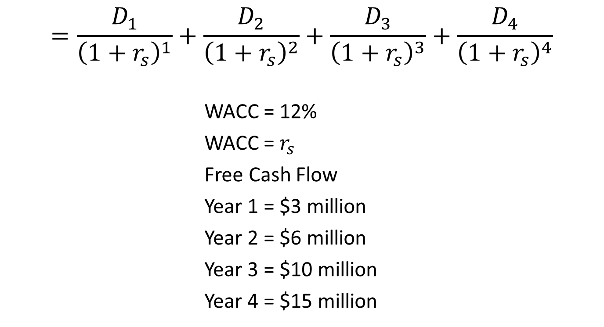
What is the present value of the free cash flows projected during the next 4 years?
$$=\frac{D_{1}}{{\left(1+r_{s}\right)}^{1}}+\frac{D_{2}}{{\left(1+r_{s}\right)}^{2}}+\frac{D_{3}}{{\left(1+r_{s}\right)}^{3}}+\frac{D_{4}}{{\left(1+r_{s}\right)}^{4}}$$
WACC = 12%
WACC = $r_{s}$
Free Cash Flow
Year 1 = $3 million
Year 2 = $6 million
Year 3 = $10 million
Year 4 = $15 million

Slide 43
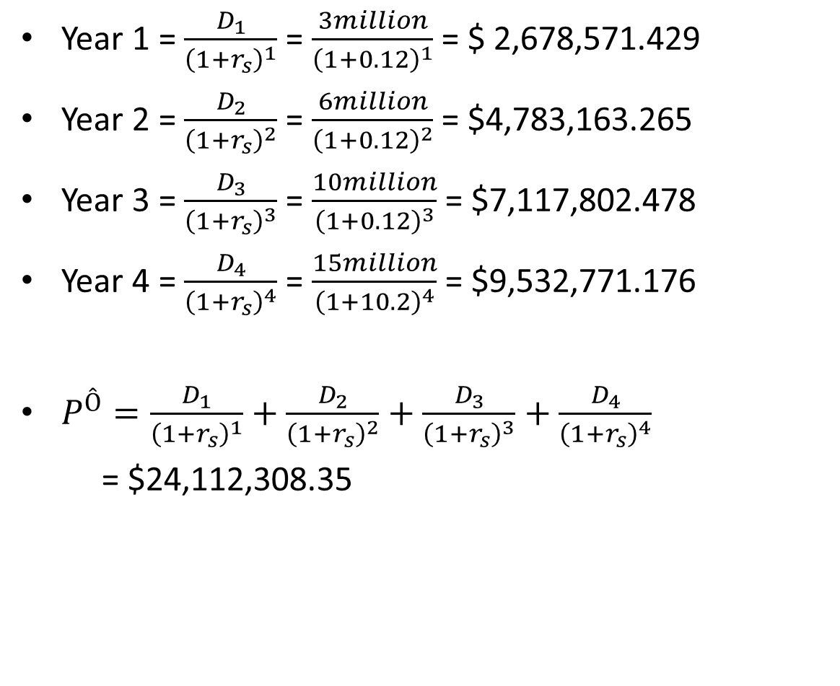
Year 1 = $\frac{D_{1}}{{\left(1+r_{s}\right)}^{1}}$ = $\frac{3million}{{\left(1+0.12\right)}^{1}}$ = $ 2,678,571.429
Year 2 = $\frac{D_{2}}{{\left(1+r_{s}\right)}^{2}}$ = $\frac{6million}{{\left(1+0.12\right)}^{2}}$ = $4,783,163.265
Year 3 = $\frac{D_{3}}{{\left(1+r_{s}\right)}^{3}}$ = $\frac{10million}{{\left(1+0.12\right)}^{3}}$ = $7,117,802.478
Year 4 = $\frac{D_{4}}{{\left(1+r_{s}\right)}^{4}}$ = $\frac{15million}{{\left(1+10.2\right)}^{4}}$ = $9,532,771.176
$P^{Ô}=\frac{D_{1}}{{\left(1+r_{s}\right)}^{1}}+\frac{D_{2}}{{\left(1+r_{s}\right)}^{2}}+\frac{D_{3}}{{\left(1+r_{s}\right)}^{3}}+\frac{D_{4}}{{\left(1+r_{s}\right)}^{4}}$
= $24,112,308.35

Slide 44
Yr 1
Calculator Method:
N = 1, I/Y = 12, FV = 3,000,000
PV = 2,678,571.429
Yr 2
Calculator Method:
N = 2, I/Y = 12, FV = 6,000,000
PV = $4,783,163.265
BEGIN MODE
INPUTS | 4 | 12 |  |  | 3,000,000
 | N | I/YR | PV | PMT | FV
OUTPUTS |  |  | -2,678,571.429
BEGIN MODE
INPUTS | 2 | 12 |  |  | 6,000,000
 | N | I/YR | PV | PMT | FV
OUTPUTS |  |  | -4,783,163.265

Slide 45
Yr 3
Calculator Method:
N = 3, I/Y = 12, FV = 10,000,000
PV = 7,117,802.478
BEGIN MODE
INPUTS | 3 | 12 |  |  | 10,000,000
 | N | I/YR | PV | PMT | FV
OUTPUTS |  |  | -7,117,802.478
Yr 4
Calculator Method:
N = 4, I/Y = 12, FV = 15,000,000
PV = 9,532,771.176
BEGIN MODE
INPUTS | 4 | 12 |  |  | 15,000,000
 | N | I/YR | PV | PMT | FV
OUTPUTS |  |  | -9,532,771.176

Slide 46
rs = 12%
0
1
2
3
4
Million
3
6
10
15
$2,678,571.429
$4,783,163.265
$7,117,802.478
$9,532,771.176
$24,112,308.350

Slide 47

What is the firm’s terminal value?
gFCF = 7%
D1 = D0(1+gFCF)
$TV=\frac{D}{WACC−gFCF}$

Slide 48

D5 = D4(1 + gFCF)
=$D_{4}{\left(1+0.07\right)}^{1}$
=$15million{\left(1+0.07\right)}^{1}$
=$16,050,000
$TV=\frac{D}{WACC−gFCF}$
$=\frac{16050000}{0.12−0.07}$
= $321,000,000

Slide 49

What is the firm’s total value today?
$PV=\frac{{FV}_{4}}{{\left(1+r\right)}^{4}}$
= $\frac{321000000}{{\left(1+0.12\right)}^{4}}$
= $204,001,303.2
Total value = $204,001,303.2 + $24,112,308.35
= $228,113,611.5

Slide 50
Calculator Method:
N = 4, I/Y = 12, FV = 321,000,000
PV = $204,001,303.2
BEGIN MODE
INPUTS | 4 | 12 |  |  | 321,000,000
 | N | I/YR | PV | PMT | FV
OUTPUTS |  |  | -204,001,303.2

Slide 51

What is an estimate of Barrett's price per share?
MV of equity = MV of Company – MV Debt
Value per share$=\frac{MV of equity}{Number of shares}$

Slide 52
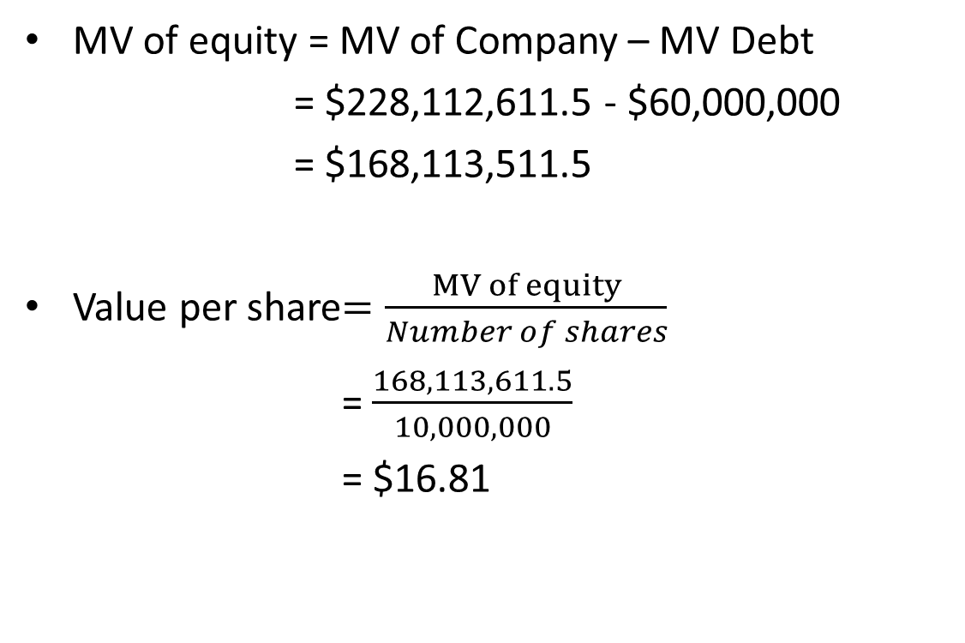
MV of equity = MV of Company – MV Debt
= $228,112,611.5 - $60,000,000
= $168,113,511.5
Value per share$=\frac{MV of equity}{Number of shares}$
= $\frac{168,113,611.5}{10,000,000}$
= $16.81

